Slide 1
RESTAURENT
Reservation BOT
VIKRAM B
Reg no: 422521104043
Dept: Computer Science and Engineering
rathod912006@gmail.com
University College of Engineering Villupuram

Slide 2
Problem Statement
Proposed Solution
System Approach
Agenda
Algorithm
Result
Conclusion
Reference

Slide 3
Problem
Statement
The project aims to develop a Restaurant Reservation Bot utilizing Long Short-Term Memory (LSTM) networks to automate the booking process. The bot will be designed to understand natural language inputs from users, such as reservation requests, party size, preferred date and time, and special requirements. Through LSTM's memory retention capabilities, the bot will maintain context throughout the conversation and generate coherent responses. Additionally, it will integrate with restaurant reservation systems to provide real-time availability updates and ensure secure handling of user data. The ultimate goal is to create a seamless and efficient reservation experience for both customers and restaurant staff.

Slide 4
PROPOSED SOLUTION
Natural Language Understanding and Generation:
Implement LSTM-based models trained on reservation-related datasets to accurately interpret user queries and generate contextually relevant responses.
Utilize techniques like attention mechanisms and context management to ensure coherent and personalized interactions.
Integration with Reservation Systems:
Develop APIs or utilize existing ones to integrate the bot with restaurant reservation systems, enabling functionalities such as checking availability, making, modifying, and canceling reservations.
Ensure secure handling of user data and compliance with data privacy regulations during interactions with reservation systems.

Slide 5
SYSTEM APPROACH
System Requirements
Hardware:
CPU: A multi-core CPU is adequate for processing user requests and running the LSTM model efficiently.
Memory (RAM): A minimum of 8GB of RAM is recommended for handling user interactions and maintaining context. Additional RAM may be beneficial for larger conversational datasets and more complex models.
Internet Connection: An internet connection is necessary for accessing external APIs, retrieving real-time reservation information, and providing updates to users.

Slide 6
SYSTEM APPROACH
2.Software:
Python: The project is implemented using the Python programming language for its versatility and extensive libraries.
TensorFlow/Keras: TensorFlow, along with its high-level API Keras, is utilized for building, training, and deploying LSTM models due to its robustness and ease of use in deep learning tasks.
Natural Language Processing (NLP) Libraries: Libraries such as NLTK (Natural Language Toolkit) or spacy are used for processing and understanding user input in natural language.
Flask: Flask (Web Framework) are employed for creating the bot's backend infrastructure, providing HTTP endpoints for communication and handling reservation requests.

Slide 7
ALGORITHM & DEPLOYMENT
LSTM Model Development:
Developed the core functionality of [Your Restaurant's Name] Bot using a Long Short-Term Memory (LSTM) deep learning model.
LSTM enables the bot to understand and generate responses based on the context of user queries, enhancing the conversational experience.
2.Training the LSTM Model:
Trained the LSTM model on a dataset comprising past booking interactions and customer preferences
Utilized techniques such as sequence modeling and backpropagation to optimize the model for accurate predictions.
3.Hyperparameter Tuning:
Conducted extensive experiments to fine-tune hyperparameters such as learning rates, sequence lengths, and network architectures.
Selected the optimal hyperparameters to improve the performance and efficiency of the LSTM model.

Slide 8
ALGORITHM & DEPLOYMENT
4.Deployment:
The trained Restaurent Bot and associated code are deployed into a GitHub repository
Included instructions for setting up the environment and running the code.
Created documentation and README files explaining the project, algorithm, and deployment instructions.
5.Performance Evaluation:
User Interaction Analysis: Evaluate the chatbot's performance by analyzing interactions between users and the bot.
Sentiment Analysis: Use sentiment analysis to gauge user satisfaction based on the sentiment expressed during conversations.
Accuracy Assessment: Measure the accuracy of the chatbot's responses by comparing them to expected outcomes
Error Analysis: Conduct an error analysis to identify common mistakes made by the chatbot and areas for improvement.

Slide 9
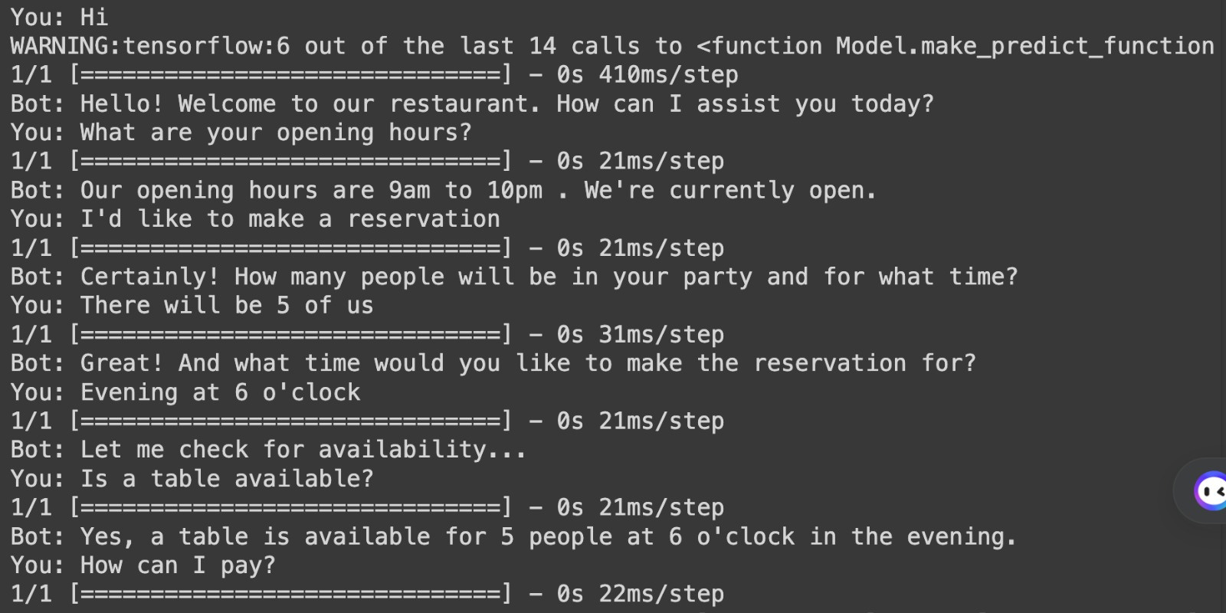
RESULT

Slide 10
CONCLUSION:
In conclusion, our restaurant chatbot, powered by LSTM deep learning technology, represents a significant advancement in customer service and operational efficiency within the dining industry. Through its ability to understand user queries, provide personalized recommendations, and seamlessly handle reservations, the chatbot streamlines the booking process and enhances the overall dining experience for customers.

Slide 11
REFERENCE
https://docs.python.org/3/library/json.html
https://numpy.org/
https://www.tensorflow.org/
https://keras.io/
https://www.tensorflow.org/api_docs/python/tf/keras/preprocessing/text/Tokenizer
https://www.tensorflow.org/api_docs/python/tf/keras/utils/pad_sequences

Slide 12
THANK YOU

